Slide 1


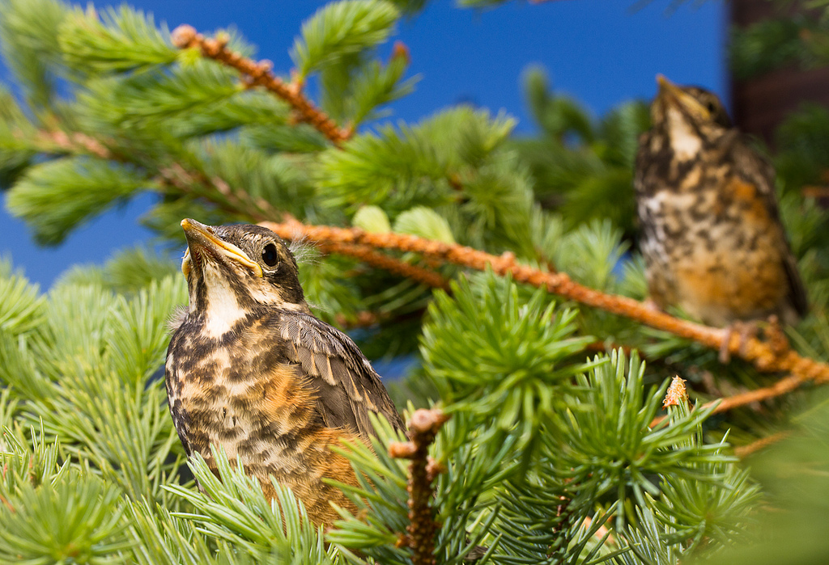
Spatio-Temporal Models for Ecologists
Spring 2024
Wed 9:00-10:20 and Fri 9-11:20 in FSH 203
FSH 556A: 5 credits graded
Instructor: James Thorson
Learn to analyze habitat use, mechanistic drivers, and movement using flexible, efficient, and scalable methods
Photo credit: Johnny Armstrong (http://www.flickr.com/photos/j-armstrong)

